Slide 1

Tom C. Rawlings
Director

Slide 2
What is our core mission in child welfare?
Courts
Law enforcement
Parent Attorney
Child Attorney
SAAG
Judge
DFCS
Community Partners
Case manager
Medical providers
Mental Health Providers
Hospitals
Supervisor
Foster care manager
Foster parents
Relatives
Social workers
Doctors/nurses
CPA staff
Educators
Neighbors
Prevention services
General social services
DJJ
DBHDD
We are part of a child protection /child welfare SYSTEM
  We should not be making unilateral decisions
  We must actively involve all voices
  We can’t be all things to all people.

Slide 3
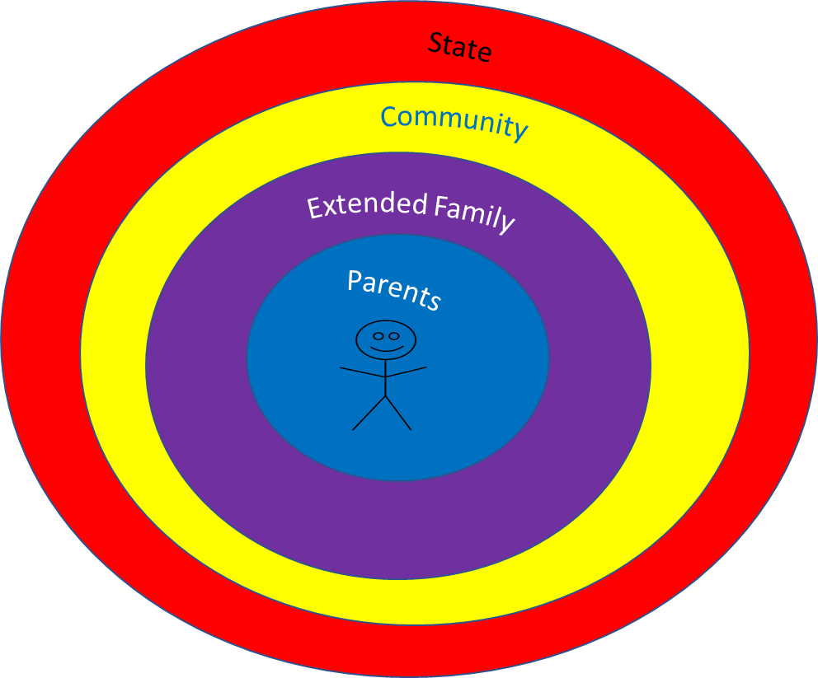
What is our core mission in child welfare?
Our main role is in supporting and collaborating with other actors in this system
  Responding to cases of child maltreatment.
  Supporting the community in building stronger families
  Ensuring we respect the right of the child to live in community

Slide 4
What is our core mission in child welfare?
We have to simplify our work and our workload to respond to the cases of highest priority.
  What are the Safety Threats if the Child Remains in the Home Without Intervention?
  What are the Child’s Vulnerabilities?
  What Parental/Caregiver Protective Capacities Exist/Are Lacking?
  The task: balancing these to determine whether the child can be kept reasonably safe in the home and/or community.

Slide 5
What is our core mission in child welfare?
4. If we can safely keep a child out of our custody and in his or her own community while we fix the family dysfunction, everybody wins.
  Less expensive
  Less traumatic
  Still provides opportunity for all partners and voices to be involved.

Slide 6
What is our core mission in child welfare?
5. Time is of the essence when a child is in our care.
  Reunification or Alternative Permanency?
“Do or not do”
        -Yoda
“Know when to hold `em, know when to fold `em.”
-Kenny Rogers
“Fish or cut bait.”
-Tom

Slide 7
UNSAFE CHILD
Out-of-Home Safety Plan
In-home Safety Plan
Effective
Not Effective
Voluntary Kinship
TAFC
Foster Care
Legal Action
Protective Order –
Court Ordered Case Plan
Dismissed
Notes:
Shows paths that can lead to court ordered FPS

Slide 8
UNSAFE CHILD
In-home Safety Plan
Effective
Not Effective
Legal Action
Protective Order –
Court Ordered Case Plan
Dismissed

Slide 9
Protective Orders – Policy 17.3
“At its discretion file a dependency petition with the juvenile court seeking a protective order to restrain or otherwise control the conduct of a parent, guardian or legal custodian or relative in a case, to:
a. Stay away from the home or the child;
b. Permit a parent, guardian or legal custodian to visit the child at stated periods;
c. Abstain from offensive conduct against the child, the child's parent, guardian or legal custodian or any person to whom custody of the child is awarded;
d. Give proper attention to the care of the home;
e. Cooperate in good faith with an agency to which custody of a child is entrusted by the court or with an agency or association to which the child is referred by the court;
f. Refrain from acts of commission or omission that tend to make the home not a proper place for the child;
g. Ensure that the child attends school pursuant to any valid law relating to compulsory attendance;
h. Participate with the child in any counseling or treatment deemed necessary after consideration of employment and other family needs; or
i. Enter and successfully complete a substance abuse program approved by the court.”

Slide 10
Religious Practices
A parent’s, guardian’s or legal custodian’s reliance on prayer or other spiritual means for healing in lieu of medical care, in the exercise of religious beliefs, shall not be the sole basis for considering the child to be a dependent child; however, the religious rights of a parent, guardian or legal custodian shall not limit the child’s access to medical care in a life-threatening situation or when the condition will result in a serious disability.
The juvenile court has the authority to order medical care of a child without DFCS taking custody.

Slide 11
UNSAFE CHILD
Out-of-Home Safety Plan
In-home Safety Plan
Effective
Not Effective
Voluntary Kinship
TAFC
Foster Care
Legal Action
Protective Order –
Court Ordered Case Plan
Dismissed

Slide 12
UNSAFE CHILD
Out-of-Home Safety Plan
In-home Safety Plan
Voluntary Kinship
TAFC
Foster Care
Resolves successfully within 90 days
Foster Care
Legal Action
Send child home, dismissed
Custody to 3rd Party
CPS Guardianship
Send child home under Protective Order
Notes:
Between Dep Petition and Guardianship, trying to work case plan with family

Slide 13
Custody to Third Party
Insufficient progress
Child’s best interests
Reasonable efforts
The parent/legal custodian is supportive of the custodial arrangement and demonstrates motivation to actively work a case plan
The safety threats can be resolved within 90 calendar days
Approved Kinship Assessment
Approved by County Director
*Obtain CD approval to close a case in which the court has granted temporary custody to the third party but has denied DFCS request for a court ordered case plan, only after efforts have been exhausted to engage the parent/legal custodian to continue services on a voluntary basis
Notes:
Insufficient progress in meeting the case plan outcomes or conditions for return
Transfer of temporary custody is in the child’s best interests
Reasonable efforts were made to maintain the family unit and prevent the unnecessary removal of the child from the home
The parent/legal custodian is supportive of the custodial arrangement and demonstrates motivation to actively work a case plan
The safety threats can be resolved within 90 calendar days
A Kinship Assessment conducted and approved
Approved by County Director
Obtain CD approval to close a case in which the court has granted temporary custody to the third party but has denied DFCS request for a court ordered case plan, only after efforts have been exhausted to engage the parent/legal custodian to continue services on a voluntary basis

Slide 14
Custody to Third Party is Not Appropriate:
Chronic and severe physical or sexual abuse cases
Serious mental health or intellectual functioning issues (parent) that cannot be resolved
Serious substance abuse situations with chronic relapse histories or the need for long term treatment
Long term incarcerations

Slide 15
UNSAFE CHILD
Out-of-Home Safety Plan
In-home Safety Plan
Voluntary Kinship
TAFC
Foster Care
Resolves successfully within 90 days
Foster Care
Legal Action
Send child home, dismissed
Custody to 3rd Party
CPS Guardianship
Send child home under Protective Order
Notes:
Between Dep Petition and Guardianship, trying to work case plan with family

Slide 16
UNSAFE CHILD
Out-of-Home Safety Plan
In-home Safety Plan
Voluntary Kinship
TAFC
Foster Care
Resolves successfully within 90 days
Foster Care
Legal Action
Send child home, dismissed
Custody to 3rd Party
CPS Guardianship
Send child home under Protective Order
Notes:
Between Dep Petition and Guardianship, trying to work case plan with family

Slide 17
CPS Guardianship
Chronic parental absence is demonstrated or chronic un-rehabilitated parental concerns
A history of caretaking for the child(ren) by the proposed guardian
Reasonable efforts were made to maintain the family unit and prevent the unnecessary removal of the child from the home
A Kinship Assessment was completed confirming the ability of the proposed guardian to provide long term supervision and care for the child(ren).
May also go through Probate Court
Written approval from County Director and Regional Director required
Notes:
May not see this very often in VK arrangements because chronic issues, or issues that are not likely to be resolved within 90 days would not be appropriate for VK Kinship in the first place, but there are times when you could see it.

Slide 18
UNSAFE CHILD
Out-of-Home Safety Plan
In-home Safety Plan
Voluntary Kinship
Foster Care
TAFC

Slide 19
UNSAFE CHILD
Out-of-Home Safety Plan
In-home Safety Plan
Voluntary Kinship
Foster Care
TAFC
Foster Care
Protective Order
Custody to 3rd Party
CPS Guardianship*

Slide 20
TAFC – Policy 22.10
“Restrains or otherwise controls the conduct of a person”
… “seek an TAFC order from the court for a child to be cared for by kinship caregivers when:
a. A request was presented to the parent/legal guardian to consider a voluntary kinship arrangement (out-of-home safety plan) to ensure child safety, but a consensus could not be achieved; and
b. Continuation of the child(ren) in the home would be contrary to his/her welfare.”
Provide or arrange for individualized services based on the developmental challenges the family is experiencing in their everyday lives, within 72 hours of identifying the need.
Initiate family preservation services (FPS) within seven business days of the issuance of a TAFC court order for a child to be temporarily cared for by a kinship caregiver(s).

Slide 22
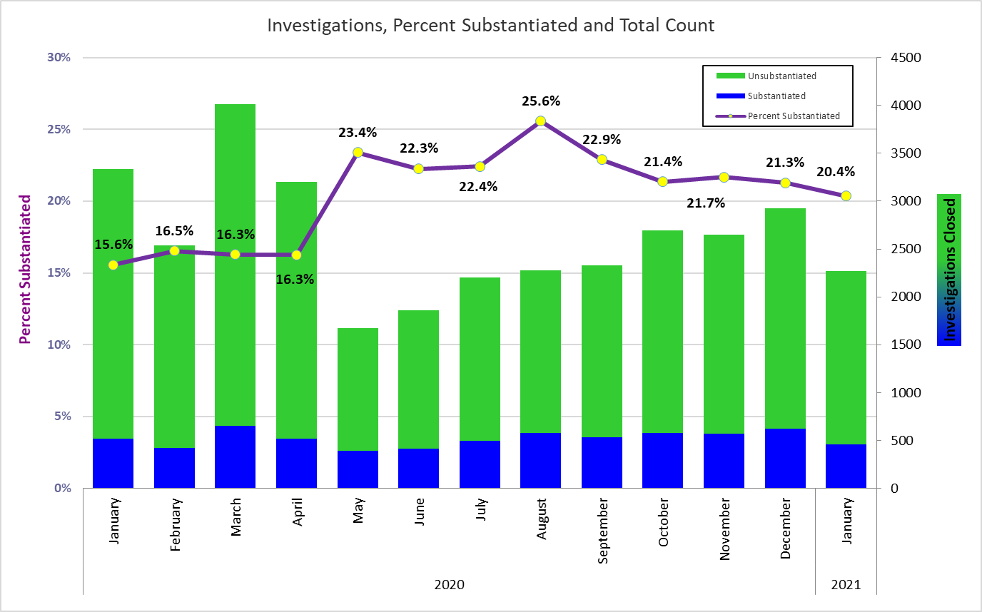

Slide 23
Recurrence of Maltreatment
Georgia |  |  |  |  |  | August 2020
Child and Family Service Review (CFSR 3) Data Profile Context Data
AFCARS and NCANDS submissions as of June 1, 2020
Guiding questions
1) How likely is it that victims of a substantiated maltreatment report experience a recurrence of abuse within 12 months?
2) Does this change by age group, race/ethnicity, county, or the year of the first substantiated report?
Observed performance on safety indicators Recurrence of maltreatment
 | Denominator (initial victims) |  |  |  | Numerator (recurring victims) |  |  |  | Percentage |  |  |  | Distribution of initial and recurring victims
 | FY 16-17 | FY 17-18 | FY 18-19 |  | FY 16-17 | FY 17-18 | FY 18-19 |  | FY 16-17 | FY 17-18 | FY 18-19 |  | FY 18-19 | FY 18-19
Age at initial victimization
Total | 19,524 | 10,697 | 10,715 |  | 947 | 359 | 378 |  | 4.9% | 3.4% | 3.5% |  | 100.0% | 100.0%
0-3 mos | 1,664 | 1,417 | 1,868 |  | 54 | 37 | 49 |  | 3.2% | 2.6% | 2.6% |  | 17.4% | 13.0%
4-11 mos | 952 | 574 | 489 |  | 47 | 22 | 14 |  | 4.9% | 3.8% | 2.9% |  | 4.6% | 3.7%
< 1 yr subtotal | 2,616 | 1,991 | 2,357 |  | 101 | 59 | 63 |  | 3.9% | 3.0% | 2.7% |  | 22.0% | 16.7%
1-5 yrs | 5,935 | 3,351 | 3,032 |  | 316 | 130 | 108 |  | 5.3% | 3.9% | 3.6% |  | 28.3% | 28.6%
6-10 yrs | 5,662 | 2,850 | 2,757 |  | 302 | 88 | 118 |  | 5.3% | 3.1% | 4.3% |  | 25.7% | 31.2%
11-16 yrs | 4,921 | 2,329 | 2,418 |  | 220 | 80 | 87 |  | 4.5% | 3.4% | 3.6% |  | 22.6% | 23.0%
17 | 390 | 176 | 151 |  | 8 | 2 | 2 |  | 2.1% | 1.1% | 1.3% |  | 1.4% | 0.5%

Slide 24

Voluntary Kinship
Voluntary Kinship serves as the foundation of Kinship Care and the main point of entry into the overall continuum. The purpose of this point of entry is to serve as a safety and crisis intervention modality that works to stabilize the family dynamic and utilizes the Solution Based Casework tenants (“natural helpers”) and practices to address the identified safety threats leading to the need for temporary out of home arrangement via an out of home Safety Plan.
To effectively engage Kinship Caregivers to care for children in CPS and Foster Care, Georgia’s Kinship Care continuum incorporates both treatment and support services throughout the continuum. When implemented and practiced with fidelity Voluntary Kinship will safely prevent unnecessary foster care entries and offer supports to kin caregivers.

Slide 25
Why is the Continuum Important?
Implementation and Practice of Voluntary Kinship focuses on both Safety and Treatment.
Applying Georgia’s practice model which engages a family’s extended supports to resolve safety and permanency concerns.
Early identification of kin caregivers to mitigate trauma to the child and to provide continuity of relationships and if long-term caregiving is required.

Slide 26
Voluntary Kinship
The Benefits:
Preserves significant family attachments, sense of personal and historic identity and culture for children.
Assists in providing continuity of care and meeting the developmental needs of children when their parents cannot.
Enables children to live with those whom they know and trust.
Reduces the trauma children experience.

Slide 27

Voluntary Kinship
The Benefits:
Strengthens Family and Community Engagement
Provides Reasonable Efforts
Serves as a form of family preservation and support.
Maximizes Natural Helpers supporting children within their family systems.

Slide 28
Voluntary Kinship Practice Guidance
The Division believes in a family-centered approach to working with families. At the core of this family centered practice is the belief that children have a right to be safe and secure, to be with their families, to be associated with their culture and to experience the least trauma or interference in their lives as is possible.
Parents are not forced to enter Voluntary Kinship Arrangements, and they must recommend and agree with the person identified to serve as kin caregiver.
Families and children have the right to integrity, privacy and due process. Kinship caregivers also have the right to be informed and involved regarding the children who have been entrusted into their care.

Slide 29
Voluntary Kinship Practice Guidance
Voluntary Kinship does not replace the critical assessment that must be done to ensure a child is safe. A voluntary kinship arrangement cannot not be considered in situations involving chronic and/or severe child maltreatment.
Situations involving chronic and /or severe patterns of abuse and neglect should be addressed with court intervention. In addition, a voluntary kinship caregiver should not be used when the safety threats cannot be mitigated via an out of home safety plan within 90 days.
When voluntary kinship is utilized improperly, it can have a negative impact on the family, and result in a loss of trust and agency credibility.

Slide 30

Seeking Court Intervention
At any time during this 90-day arrangement if the caregiver is showing minimal to no progress towards behavioral change, or the conditions for return cannot be met court intervention must be pursued immediately.
Good supervision and case work practice will reflect court action taken on all cases prior the 90th day.

Slide 31
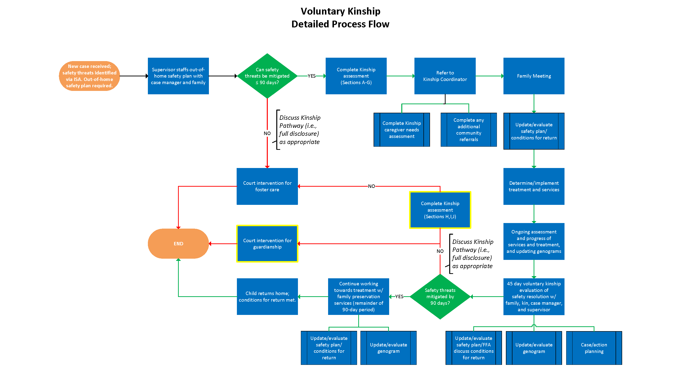

7-10 day Family Meeting
Seek
45th Day Meeting

Slide 33
Voluntary Kinship Package
Goal: Design a program that:
  Identifies children who are not safe with parents, whose parental issues we believe we can fix within six months, and who have an identified relative/fictive kin with whom they might stay voluntarily.
  Provides financial support to the relative or fictive-kin caregiver, starting on day 1 of the kinship arrangement, to include:
    A stipend for the child’s care
    Free/subsidized daycare
  Provides “expanded family preservation” services that help the kinship caregiver, the child, and the parent.
  Holds to a deadline of six months:
    When child is safe, return to family preservation.
    If parent uncooperative and child is not safe, look at relative foster care.
Cost of six-month foster care stay: $13,500 minimum (not counting additional administrative burdens).
Cost of six-month voluntary kinship package:
  Child care: $4320
  Supportive services: $1500
  Enhanced TANF: $1800
    ========
    $10,620

