Slide 1
MULTI-DISIPLINARY CHILD ABUSE & NEGLECT INSTITUTE
The Family Time Practice Guide:
Introduction and Challenges to Implementation
Judge R. Michael Key and Dr. Priscilla Faulkner
National Council of Juvenile and Family Court Judges and
Georgia Supreme Court Committee on Justice for Children
Georgia,
2021
Notes:
The Judge Presenter starts the presentation and introduces the DFCS Presenter. Talks about the important of case planning.
DFCS portions of the presentation are indicated by being underlined in the notes.

Slide 2
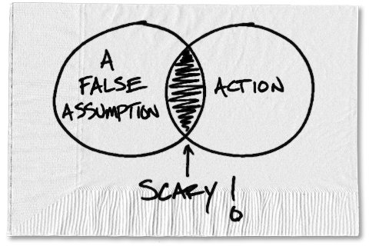
ASSUMPTIONS
Everyone agrees with the importance of meaningful family time for children in care
Everyone understands the difference in “visitation” and “family time”
Everyone wants to provide the most and highest quality family time possible
Family time is healthy for most
children in care
Family time is healthy for most
children of incarcerated
parents
This Photo by Unknown Author is licensed under CC BY

Slide 3
learning objectives
Know the history of the Family Time Practice Guide
Identify some of the challenges to implementation of the Family Time Practice Guide
Learn ways to overcome some of the challenges to implementation of Family Time Practice Guide

Slide 4
The History of the Family Time practice guide
2
0
0
4

Slide 5
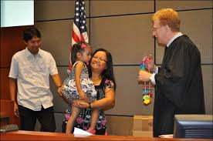
Family time and Georgia Law
A period of access…in order to maintain parental and familial involvement
Reasonable…consistent with the age and
developmental needs
Consistent with the child’s
best interest
Specify frequency, duration
and terms
Court review for appropriateness
where there is a lack of substantial progress
Notes:
Georgia DFCS Policy Number 10.19: Visitation (June 2016), referencing O.C.G.A § 19-7-3, O.C.G.A § 15-11-2(33) [NOTE THAT THIS CITE IS WRONG], O.C.G.A § 15-11-26, O.C.G.A § 15-11-112, “When a child is removed from his or her home, the court shall order reasonable visitation that is consistent with the age and developmental needs of a child if the court finds that it is in a child’s best interest. The court’s order shall specify the frequency, duration, and terms of visitation including whether or not visitation shall be supervised or unsupervised. NOTE: There shall be a presumption that visitation will be unsupervised unless the court finds that unsupervised visitation is not in a child’s best interest.”
NCJFCJ Enhanced Guidelines, page 141.
O.C.G.A. Section 15-11-2(75) “Visitation” means a period of access to a child by a parent, guardian, legal custodian, sibling, other relative, or any other person who has demonstrated an ongoing commitment to a child in order to maintain parental and familial involvement in a child's life when he or she is not residing with such person.
Ga. Code Ann., § 15-11-112
§ 15-11-112. Court-ordered visitation
Currentness
(a) When a child is removed from his or her home, the court shall order reasonable visitation that is consistent with the age and developmental needs of a child if the court finds that it is in a child's best interests. The court's order shall specify the frequency, duration, and terms of visitation including whether or not visitation shall be supervised or unsupervised.
(b) There shall be a presumption that visitation shall be unsupervised unless the court finds that unsupervised visitation is not in a child's best interests.
(c) Within 30 days of the court finding that there is a lack of substantial progress towards completion of a case plan, the court shall review the terms of visitation and determine whether the terms continue to be appropriate for a child or whether the terms need to be modified.
Credits
Laws 2013, Act 127, § 1-1, eff. Jan. 1, 2014.

Slide 6
Relevant Best interest factors
Physical safety
Love, affection, bonding and emotional ties to parent, siblings, etc.
Child’s need for stability and continuity of relationships with wide range of people
Child’s sense of attachments, including sense of security and familiarity, and continuity of affection for child
Capacity and disposition of parent to care for child and give love, affection, and guidance
Home environment
Stability of family unit
Mental and physical health of all individuals
Child’s background and ties, including familial, cultural, and religious
Uniqueness of every family
Child’s wishes
Family violence
Recommendations of court-appointed evaluator or GAL
Notes:
Emphasis again (as in P2) the importance of making best interest determinations around the statutory factors. The factor on these slides are the ones most relevant to family time. We often make family time decisions around some of these factors, but not in a structured way and not always considering all of the factors. We can even use the Peanuts story for this. Particularly around the issue of unsupervised visitation when we get to it, every step back from supervised visitation should be informed/driven by these factors.
Ga. Code Ann., § 15-11-26
§ 15-11-26. Factors considered in determination of best interests of child
Currentness
Whenever a best interests determination is required, the court shall consider and evaluate all of the factors affecting the best interests of the child in the context of such child's age and developmental needs. Such factors shall include:
(1) The physical safety and welfare of such child, including food, shelter, health, and clothing;
(2) The love, affection, bonding, and emotional ties existing between such child and each parent or person available to care for such child;
(3) The love, affection, bonding, and emotional ties existing between such child and his or her siblings, half siblings, and stepsiblings and the residence of such other children;
(4) Such child's need for permanence, including such child's need for stability and continuity of relationships with his or her parent, siblings, other relatives, and any other person who has provided significant care to such child;
(5) Such child's sense of attachments, including his or her sense of security and familiarity, and continuity of affection for such child;
(6) The capacity and disposition of each parent or person available to care for such child to give him or her love, affection, and guidance and to continue the education and rearing of such child;
(7) The home environment of each parent or person available to care for such child considering the promotion of such child's nurturance and safety rather than superficial or material factors;
(8) The stability of the family unit and the presence or absence of support systems within the community to benefit such child;
(9) The mental and physical health of all individuals involved;
(10) The home, school, and community record and history of such child, as well as any health or educational special needs of such child;
(11) Such child's community ties, including church, school, and friends;
(12) Such child's background and ties, including familial, cultural, and religious;
(13) The least disruptive placement alternative for such child;
(14) The uniqueness of every family and child;
(15) The risks attendant to entering and being in substitute care;
(16) Such child's wishes and long-term goals;
(17) The preferences of the persons available to care for such child;
(18) Any evidence of family violence, substance abuse, criminal history, or sexual, mental, or physical child abuse in any current, past, or considered home for such child;
(19) Any recommendation by a court appointed custody evaluator or guardian ad litem; and
(20) Any other factors considered by the court to be relevant and proper to its determination.
Credits
Laws 2013, Act 127, § 1-1, eff. Jan. 1, 2014.

Slide 7
Presumption for unsupervised visitation
“There shall be a presumption that visitation shall be unsupervised unless the court finds that unsupervised visitation is not in a child's best interests.” O.C.G.A. Section 15-11-12(B)
Is that really happening? If not, why not?
What factors should we consider before
requiring supervision?
Make it a process. Begin with unsupervised
and walk it back one step at a time from
the least restrictive to the most restrictive.
Notes:
First Point. The law is the law and presumably, all relevant factors were considered in making the presumption of unsupervised visitation the public policy of the State. Therefore, every step back from supervised visitation should be informed/driven by these factors. That is to say we should be able to say that we are stepping back from the least restrictive form of visitation to the most restrictive form based on a statutory factor.
Second Point. Talk about the relevant bias in decision making factors.
REFLECTIONS ON THE DECISION-MAKING PROCESS TO PREVENT BIAS – Ones in bold.
Take a moment before every hearing or before making decisions in a case to ask yourself:
What assumptions have I made about the cultural identity, genders, and background of this family?
What is my understanding of this family's unique culture and circumstances?
How is my decision specific to this child and this family?
How has the court's past contact and involvement with this family influenced (or might influence) my decision-making process and findings?
What evidence has supported every conclusion I have drawn, and how have I challenged unsupported assumptions?
Am I convinced that reasonable efforts (or active efforts in ICWA cases) have been made in an individualized way to match the needs of the family?
Am I considering relatives as preferred placement options as long as they can protect the child and support the permanency plan?
Have I placed the child in foster care as a last resort?
Have I integrated the parents, children, and family members into the hearing process in a way that ensures they have had the opportunity to be heard, respected, and valued? Have I offered the family and children the chance to respond to each of the questions from their perspective?
Is this family receiving the same level and tailoring of services as other families?
Is the parents' uncooperative or negative behavior rationally related to the involvement of the agency and/or the court?
If this were my child, would I be making the same decision? If not, why not?

Slide 8
Frequency and duration under the Family time practice guide
Presumptive Family Time
Age | Presumptive Family Time Frequency and Duration
Birth to 3 years | 1 ½ to 2 hours three times per week
3 years to 12 years | 2 or more hours at least two times per week
12 years to 18 years | 1 or more hours one or two times per week, with consideration for the youth’s scheduled activities
Notes:
Talk a little bit about how we moved from where we were originally were to this. Most of the discussion around this will be in the challenges slide.

Slide 9
Frequency and duration under DFCS Policy
Minimum Family Time Unless the Court Specifies Another Visitation Arrangement
Age | Family Time Frequency
Birth to 2 years | Not less than two times per week
3 years to 5 years | Not less than one time per week
All children | Not less than once every other week
Notes:
10.19 Visitation confirmed current as of April 7, 2021 by Lori Davis

Slide 10
Common challenges to family time
Parental drug use
Failure to comply with case plan or rules in treatment
Pattern of missed family
time
Out-of-county placement
Transportation
Bias, fear, laziness?
Others?
Notes:
Get the group to list challenges and then talk about them, particularly how to overcome the challenges.

Slide 11
Incarcerated parents flip the script
Why can’t incarcerated parents visit with their children?
Why can’t children visit with their incarcerated parents?

Slide 12
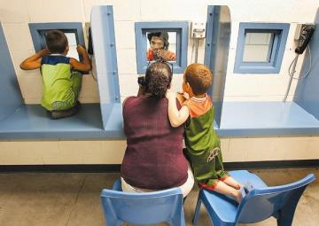
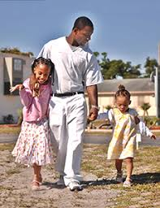
Incarcerated parents
We need to move…
from here… →
to here…
↓
to here. →
Notes:
This will also largely be discussion. First try to find out what is going on around the various jurisdictions. Then, problem solve.

Slide 13
FAMILY TIME AT THE TROUP COUNTY JAIL
Initially just one hour once a week on Tuesdays
Initially no more than five families
Initially just children in foster care
Facilitated by parent aide
Family friendly room
Parent unshackled
Deputy in the room as
innocuous as possible
Appropriate toys, books,
etc.
This Photo by Unknown Author is licensed under CC BY-NC-ND
Notes:
From Shelia: There was discussion around supporting the children when visitation doesn't happen, which cases might be most appropriate to start the program and not withhold visitation as a punishment, however what you have on the slide were the main points.

Slide 14
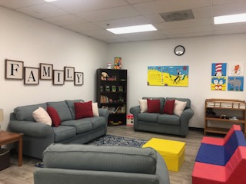
Family Reunification Room
Family Reunification Room

Slide 15
Next steps
What are your next steps?
How do we implement state-wide?
What are your next steps locally?

Slide 16
QUESTIONS

